Slide 1

In Search of efficiency
Predicting Garment Employee productivity
By: Tamjid Ahsan
Date: May 27, 2021, 05:00 PM [DST]

Slide 2
Overview
The garment industry one of the highly labor-intensive industries.
Often production goals are not met.
This is a high priority for an organization to achieve deadline and maximize profit by ensuring proper utilization of resources.
Critical component of Lean manufacturing

Slide 3
Business Problem
A garment production pipeline consists of a handful of sequential processes, e.g., designing, sample confirmation, sourcing and merchandising, lay planning, spreading and cutting, sewing, finishing and so on.
To complete a whole production within a target time, these sequential processes need to be to performed efficiently. Industrial engineers strategically set a targeted productivity value against each working team in the manufacturing process.
However, it is a common scenario that the actual productivity does not align with the target for several factors, both internal and external.
The goal is to predict whether employee met productivity target, with high precision.

Slide 4
Methodology
The collected dataset contains the production data of the sewing and finishing department for three months from January 2015 to March 2015 of the renowned garment manufacturing company in Bangladesh.
Cleaned dataset consists of 1197 instances and includes 13 attributes.
Machine Learning models were used for predicting binary classification.
Target met OR not met.
Focus was on maximizing prediction of the instances where production target were not met with high confidence.

Slide 5
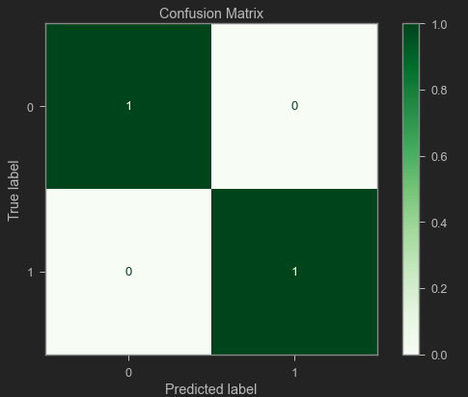
Methodology - Model
Using “random subsampled decision trees”* modeling technique yielded best performance.
Accuracy of 100%. (Quite uncommon outcome)
* On test data
* More details about model is in the appendix

Slide 6

Let's start with some exploration
The Prominent Ones

Slide 7
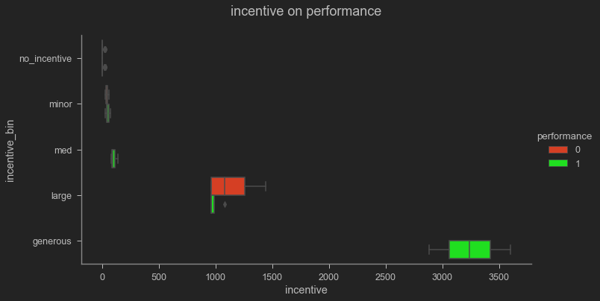
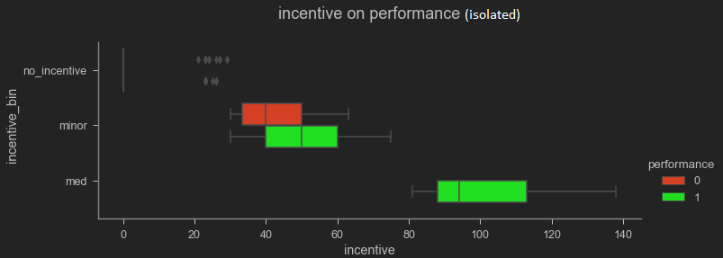
Incentive
Even a minor incentive have positive impact on performance.

Slide 8
Incentive
Even a minor incentive have positive impact on performance.

Slide 9
Incentive
Even a minor incentive have positive impact on performance.

Slide 10
Incentive
Even a minor incentive have positive impact on performance.
Try to give incentive if possible

Slide 11
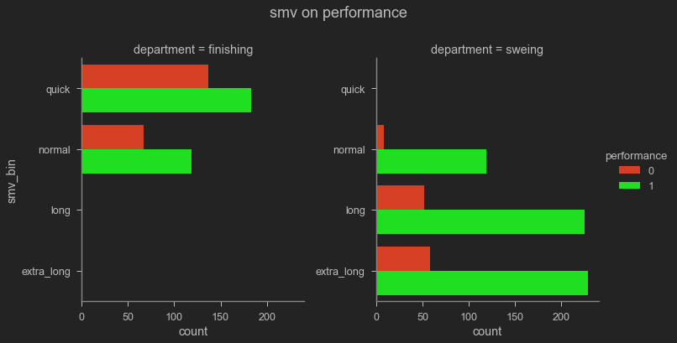
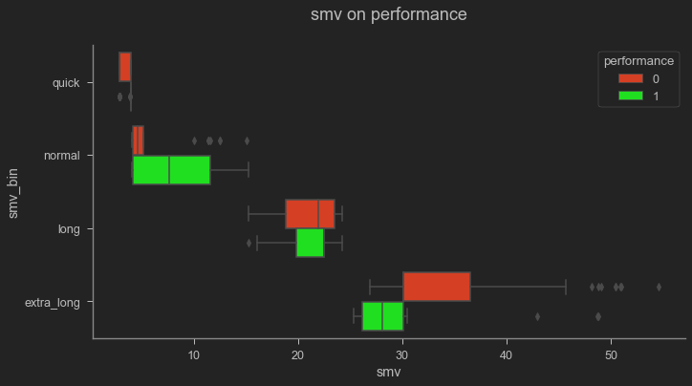
SMV standard Minute value
Generally, employees in can meet their goal.
Finishing department has hard time meeting goal
They are not efficient on very short and long tasks.
Higher or lower SMV tends to lead towards goal not met.
When are they not meeting goals?
Re-evaluate assigned minute values because:
They might not be well trained quick and long task
OR
Assigned SMV is not reflective of the task in hand

Slide 12
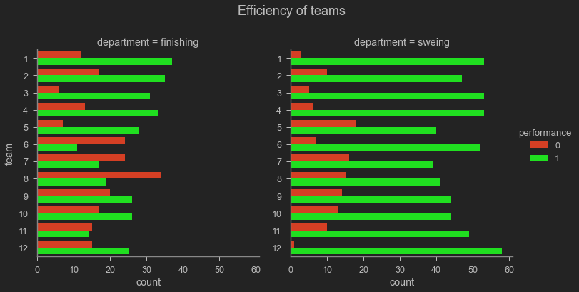
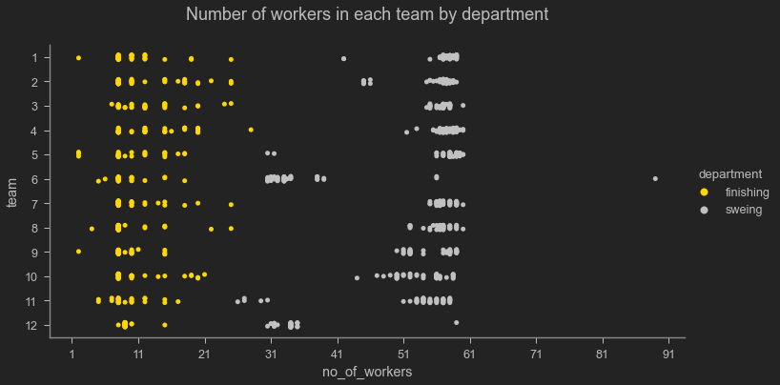
Team
Generally finishing department worker size is low.
Finishing department fails to achieve goal more often.
Do they have enough manpower?

Slide 13
Peeking into a black box
Random Subsampled Decision Trees

Slide 14
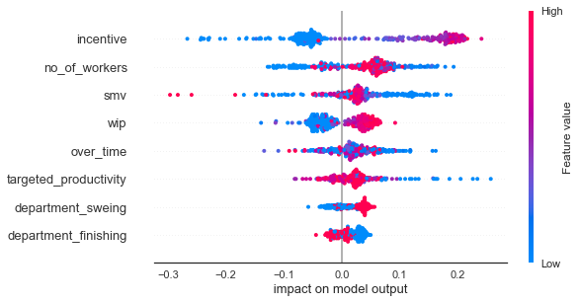
Feature Importance
(Goal met)
* Impact on model output is calculated using SHAPLY values which is based on game theory.
Notes:
Label axis

Slide 15
Recommendations
Use insights from features to tune manufacturing process as is.
Train employees to be more efficient, especially for short and long tasks.
Reassign metrics if necessary
SMV, are they reflective of the task?
Targeted productivity, are they achievable?
Evaluate team size, especially in finishing department and adjust accordingly.
Use this model for predicting performance and tune production process accordingly.

Slide 16
Next steps
do a multi-class prediction by further binning of target.
fit a model with entire data and prepare for production use.

Slide 17
THANK YOU
GitHub: @tamjid-ahsan
LinkedIn: linkedin.com/in/tamjidahsan/
Project repo: https://github.com/tamjid-ahsan/dsc-phase-3-project

Slide 18

Appendix

Slide 19
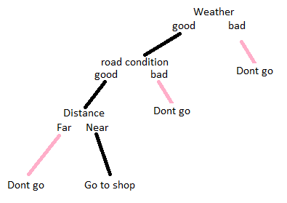
Random Forest™ A.K.A. Random Subsampled Decision Trees
Let's start with a decision tree
A hypothetical scenario
You want to go to grocery to by potato.
You either go or don’t.
Factors influence
Weather
Distance
Road condition
* The actual process is much more complex than that. This example is more of a flow chart.

Slide 20
Random Forest™ A.K.A. Random Subsampled Decision Trees
Random Subsampling
Best performing trees?
Different combination of:
Weather
Distance
Road condition
You want to buy either an iPhone or android. Then ask three of your friends about suggestion.
Friend 1 says to buy an iPhone because of the brand value.
Friend 2 says to buy an Android phone because it is affordable.
Friend 3 says to buy an iPhone because of the cameras.
Now you found out that the majority of your friends suggested an iPhone. You decided to buy an iPhone after finding out which decision gets the majority votes. This is the basic idea behind the Random forest classifier.
Trees, with an emphasis on the “s”
Creates a hoard of those trees and measures performance.
Then selects the best performing trees.

Slide 21
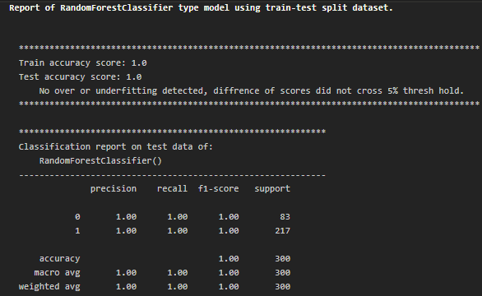
Performance Metrics of the RF model

Slide 22
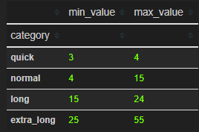
SMV Binning, minutes

Slide 23
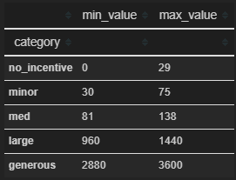
Incentive Binning, in BDT

